Slide 1
Applied Nhibernate
Ross Beehler
rossbeehler@gmail.com

Slide 2
Agenda
NHibernate Overview
NHibernate in a Data Access Layer
Testing with NHibernate

Slide 3
Why Use an ORM?
Typically database agnostic
DRY – prevent duplication of ADO.NET code
Separate Responsibilities (SRP):
mapping of relational tables to objects
conversion of database types to .NET types
Query logic
Many “free” features: Lazy Loading, Dirty Checking, SQL Batching, Caching, Optimistic Locking, etc.
Bottom Line: Testable/Maintainable code!

Slide 4
Why NHibernate?
Rich history and features:
Based on Java’s Hibernate (2001)
Open Source, starting 2005, now in v3.0
Most feature rich free ORM on .NET
Extensive community support
28,000+ official forum messages
250,000+ downloads since Jan 2010
Many community/partner projects
Fluent NHibernate
NHibernate Profiler
Notes:
EntityFramework, DataObjects.NET

Slide 5
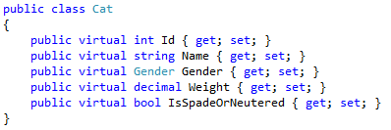
NHibernate Mapping
CAT table:
Cat class:
CAT_ID | NAME | SEX | WEIGHT | SPADE_NEUTERED
1 | Mittens | 0 | 3.5 | Y
2 | Princess | 0 | 4 | Y
3 | Smelly | 1 | 20 | N

Slide 6
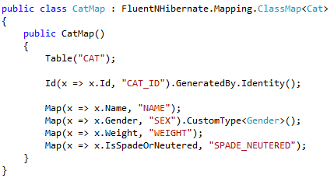
Fluent NHibernate Mapping
Notes:
Hibernate: 2001

Slide 7
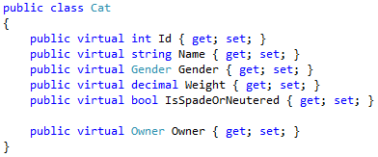
Many-To-One Mapping
CAT table:
Cat class:
CAT_ID | NAME | SEX | WEIGHT | SPADE_NEUTERED | OWNER_ID
1 | Mittens | 0 | 3.5 | Y | 8
2 | Princess | 0 | 4 | Y | 9
3 | Smelly | 1 | 20 | N | NULL

Slide 8
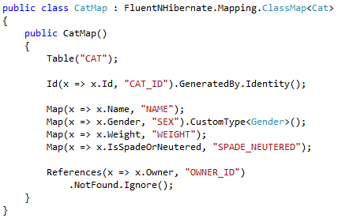
Many-To-One Mapping

Slide 9
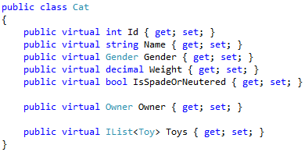
One-To-Many Mapping

Slide 10
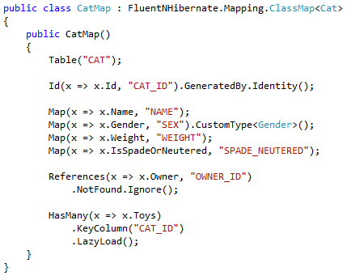
One-To-Many Mapping

Slide 11
NHibernate ISessionFactory
Used to apply mappings and configurations for a given database
Opens ISession instances (connections)
Expensive!
Create once per app-domain and cache
Must parse and validate all configuration (XML)
Can take a couple seconds or more for complicated schemas

Slide 12
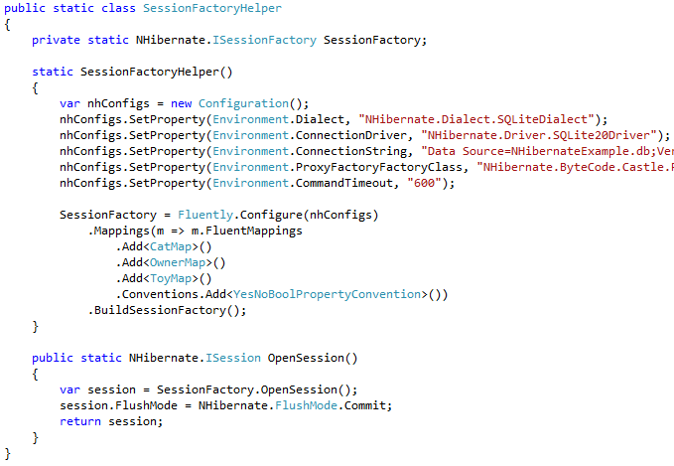
NHibernate ISessionFactory
Notes:
Hibernate: 2001

Slide 13
NHibernate ISession
Represents a database connection
Used to perform CRUD operations
As cheap as opening an ADO.NET connection
Maintains a 1st Level Cache
“Gets” by Id will pull from the cache
Allows for automatic dirty checking
Allows for optimistic locking
BUT … will kill you if you load too much at once
Use IStatelessSession for processing lots of data or multiple ISessions.

Slide 14
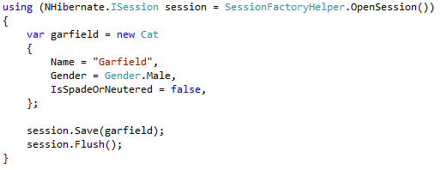
NHibernate ISession
ISession.Save to insert
ISession.Flush to apply any pending changes

Slide 15
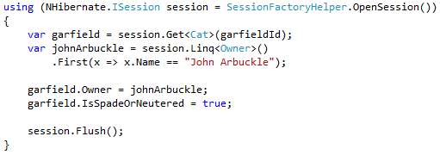
NHibernate ISession
ISession.Get to retrieve by Id
ISession.Linq<T> to use Linq to NHibernate
ISession.Flush will update all dirty models

Slide 16
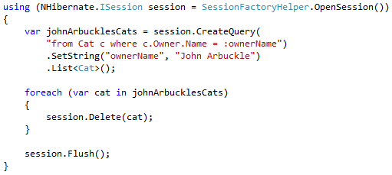
NHibernate ISession
ISession.CreateQuery to start an HQL query
Query over the domain models
Easy joins using dot-notation
ISession.Delete to delete a model

Slide 17
NHibernate ISession Tips
Set FlushMode to Commit to prevent “random” db roundtrips
Use one ISession per user interaction in web/UI applications.
Native SQL available via CreateSQLQuery().
Pre-fetch data and/or use SQL batching if database round trips are a concern
If you need ADO.NET, extract the IDbConnection from the ISession.Connection property
Use log4net and the “NHibernate.SQL” logger to view SQL generated
“NHibernate” logger for all configuration/processing

Slide 18
Agenda
NHibernate Overview
NHibernate in a Data Access Layer
Testing with NHibernate

Slide 19
Data Access Layer
Why another layer?
Single Responsibility Principle
Defer querying to a lower level
BL is cluttered enough without data access logic.
Dependency Inversion Principle
BL shouldn’t know how or by who data is accessed.
Main reason: testability
The good news: with NHibernate (or any ORM), even our DAL is clean.

Slide 20
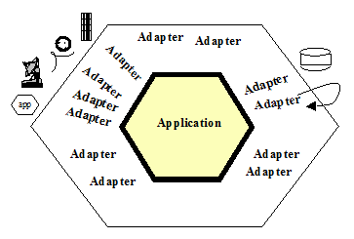
Data Access Layer
Alistair Cockburn’s Hexagonal Architecture:

Slide 21
Data Access Layer Rules
Domain logic should be able to simply ask the DAL for data in its own language.
Alternatively: The DAL should not impose an unclear interface on the domain.
This is a forgotten goal of the Dependency Inversion Principal.
Domain logic should never leak into the DAL.

Slide 22
Data Access Layer
Problem #1: The NHibernate ISession is huge!
Connection scope
Transactions
Caching/Flushing
CRUD operations
We do not want our domain logic having direct access to all of this behavior.

Slide 23
Data Access Layer
Unit of Work Pattern
Maintains a list of objects affected by a business transaction and coordinates the writing out of changes and the resolution of concurrency problems. [Fowler: PoEAA]
This describes some of the (many) responsibilities of the NHibernate ISession.
Scope of a connection
Transactions
1st Level Cache Behavior

Slide 24
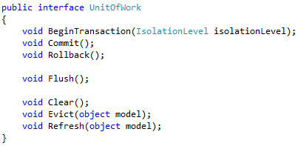

Data Access Layer Patterns

Slide 25
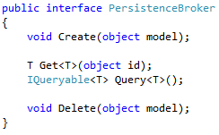
Data Access Layer Patterns
What about the ISession's CRUD operations?
This interface should be internal to the DAL if your IoC container allows!
Notes:
Underlying implementation obtains UnitOfWork/ISession via ThreadStatic state.

Slide 26
Data Access Layer
Problem #2: Uniform Domain-centric Interface needed.
Repository Pattern
Mediates between the domain and data mapping layers using a collection-like interface for accessing domain objects.
[Fowler: PoEAA]

Slide 27
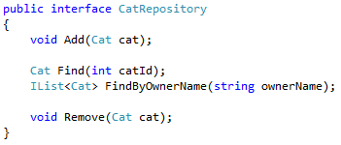
Data Access Layer

Slide 28
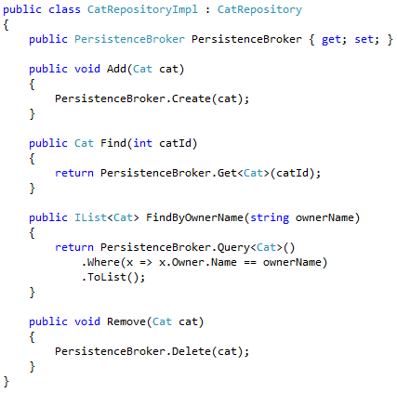
Data Access Layer

Slide 29
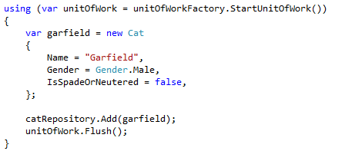
Data Access Layer Usage

Slide 30
Agenda
NHibernate Overview
NHibernate in a Data Access Layer
Testing with NHibernate

Slide 31
Testing with NHibernate
Alistair Cockburn’s Hexagonal Architecture:
Notes:
Michael Feathers: Legacy code is defined as code without automated tests.
Uncle Bob: You are not conducting yourself as a professional if you do not seriously aim for 100% automated code coverage.

Slide 32
Testing with NHibernate
Automated Testing Pyramid
UI
E2E
Selenium, Watir, Watin
Integration
MSTest, xUnit, MSpec
Acceptance
FitNesse, Cucumber
Unit
MSTest, xUnit, MSpec

Slide 33
Unit Testing NHibernate
Unit test domain logic by stub/mocking repository interfaces.
Unit test repositories
Stub/mock PersistenceBroker.
Use Linq to NHibernate whenever possible and use List<T>.AsQueryable() to completely cover your query.
Cannot really unit test when using HQL or direct SQL.

Slide 34
Unit Testing NHibernate

Slide 35
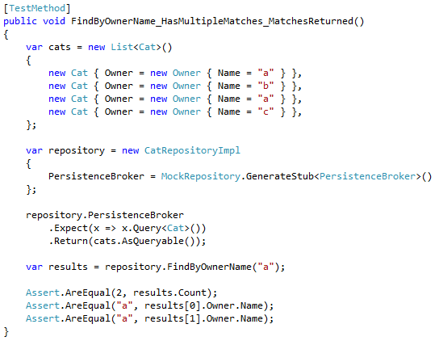
Unit Testing

Slide 36
Integration Testing
Unit tests cannot cover:
NHibernate mappings
ISessionFactory configuration.
Connection strings and other DAL application configuration.
HQL and direct SQL.
Enter Integration Tests
Do not depend on End-To-End/UI tests to cover the above!!!
One test for repository methods you can unit test.
Tests to fully cover any HQL/SQL.

Slide 37
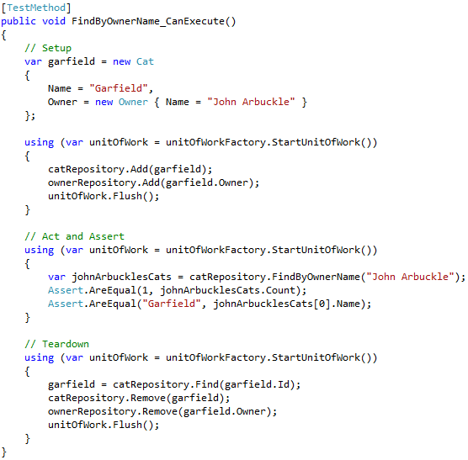
Integration Testing

Slide 38
Acceptance Testing
Tests written for (by) customers.
Test everything in the “inner-hexagon”
External dependencies are not used (DB, file system, web services, etc.)
Use stubs in the “adapter” layer.
Depending on IoC container, may make more sense to use hand-created stub classes instead of auto-generated stubs/mocks.
For DAL, create “in-memory” repository implementations and fill with test data.

Slide 39
Testing Summary
Unit test whatever you can
Integration test what you can’t unit test
Provide DAL abstractions so that Acceptance tests do not use NHibernate but “in-memory” stubs instead.

Slide 40
Resources
http://nhforge.org/ - NHibernate’s home
http://www.amazon.com/Patterns-Enterprise-Application-Architecture-Martin/dp/0321127420
http://alistair.cockburn.us/Hexagonal+architecture

Slide 41
Questions?
Ross Beehler
rossbeehler@gmail.com

